Slide 1

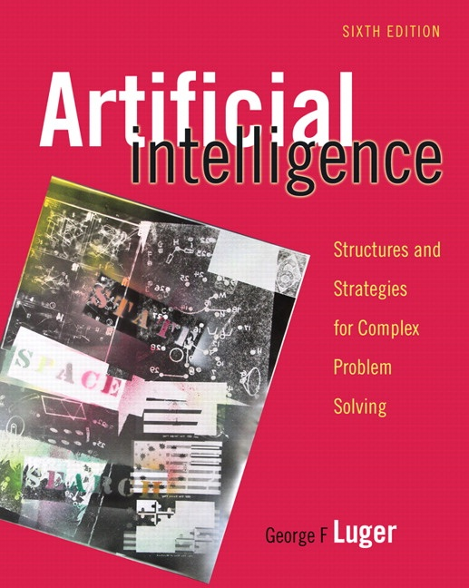
STOCHASTIC METHODS
5.0 Introduction
5.1 The Elements of Counting
5.2 Elements of Probability Theory
5.3 Applications of the Stochastic Methodology
5.4 Bayes’ Theorem
5.5 Epilogue and References
5.6 Exercises
George F Luger
ARTIFICIAL INTELLIGENCE 6th edition
Structures and Strategies for Complex Problem Solving
Luger: Artificial Intelligence, 6th edition. © Pearson Education Limited, 2009
1

Slide 2
Diagnostic Reasoning. In medical diagnosis, for example, there is not always an obvious cause/effect relationship between the set of symptoms presented by the patient and the causes of these symptoms. In fact, the same sets of symptoms often suggest multiple possible causes.
Natural language understanding. If a computer is to understand and use a human language, that computer must be able to characterize how humans themselves use that language. Words, expressions, and metaphors are learned, but also change and evolve as they are used over time.
Planning and scheduling. When an agent forms a plan, for example, a vacation trip by automobile, it is often the case that no deterministic sequence of operations is guaranteed to succeed. What happens if the car breaks down, if the car ferry is cancelled on a specific day, if a hotel is fully booked, even though a reservation was made?
Learning. The three previous areas mentioned for stochastic technology can also be seen as domains for automated learning. An important component of many stochastic systems is that they have the ability to sample situations and learn over time.
Luger: Artificial Intelligence, 6th edition. © Pearson Education Limited, 2009
2

Slide 3
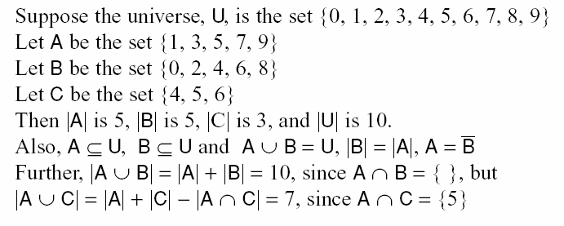
Luger: Artificial Intelligence, 6th edition. © Pearson Education Limited, 2009
3
Notes:
Insert 8 indented lines from “suppose” to “{5}” pg 168

Slide 4

The Addition rule for combining two sets:
The Addition rule for combining three sets:
This Addition rule may be generalized to any finite number of sets
Luger: Artificial Intelligence, 6th edition. © Pearson Education Limited, 2009
4

Slide 5


The Cartesian Product of two sets A and B
The multiplication principle of counting, for two sets
Luger: Artificial Intelligence, 6th edition. © Pearson Education Limited, 2009
5

Slide 6

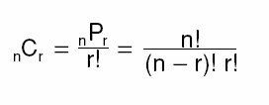
The permutations of a set of n elements taken r at a time
The combinations of a set of n elements taken r at a time
Luger: Artificial Intelligence, 6th edition. © Pearson Education Limited, 2009
6

Slide 7
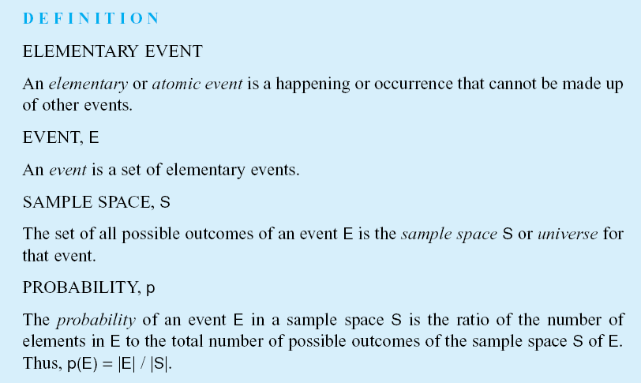
Luger: Artificial Intelligence, 6th edition. © Pearson Education Limited, 2009
7

Slide 8



The probability of any event E from the sample space S is:
The sum of the probabilities of all possible outcomes is 1
The probability of the compliment of an event is
The probability of the contradictory or false outcome of an event
Luger: Artificial Intelligence, 6th edition. © Pearson Education Limited, 2009
8

Slide 9
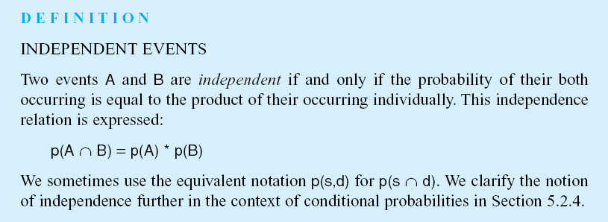
Luger: Artificial Intelligence, 6th edition. © Pearson Education Limited, 2009
9

Slide 10
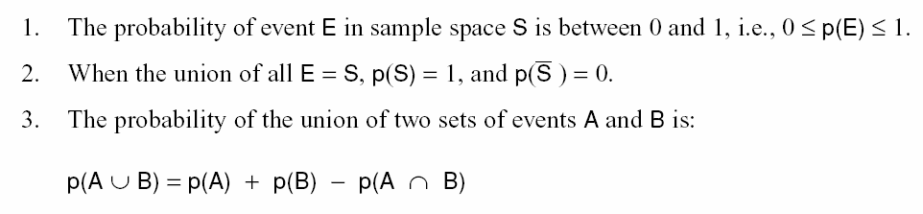
The three Kolmogorov Axioms:
Luger: Artificial Intelligence, 6th edition. © Pearson Education Limited, 2009
10
Notes:
Insert lines 3, 4, 5, & 6 pg 174

Slide 11
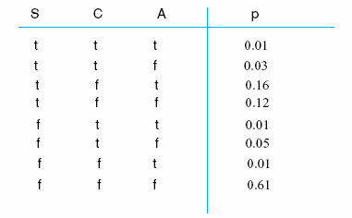
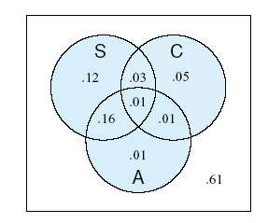
Table 5.1 The joint probability distribution for the traffic slowdown, S, accident, A, and construction, C, variable of the example of Section 5.3.2
Fig 5.1 A Venn diagram representation of the probability distributions of Table 5.1; S is traffic slowdown, A is accident, C is construction.
Luger: Artificial Intelligence, 6th edition. © Pearson Education Limited, 2009
11

Slide 12
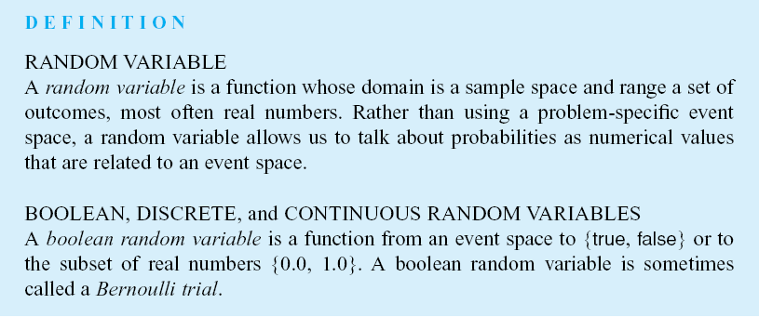
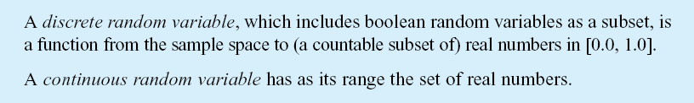
Luger: Artificial Intelligence, 6th edition. © Pearson Education Limited, 2009
12

Slide 13
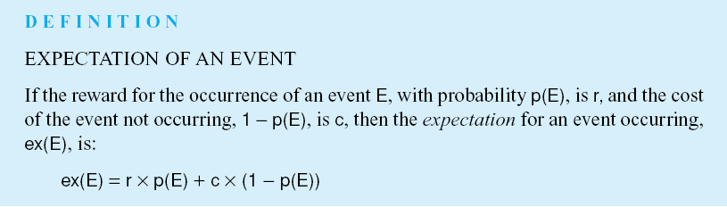
Luger: Artificial Intelligence, 6th edition. © Pearson Education Limited, 2009
13

Slide 14
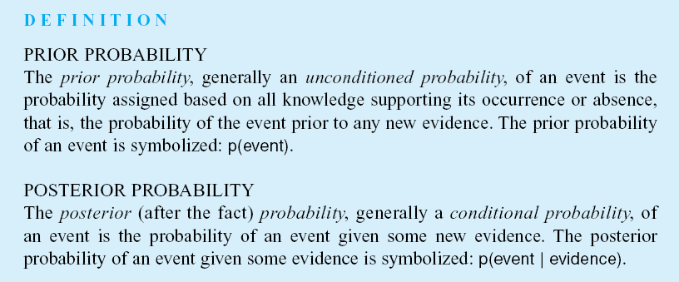
Luger: Artificial Intelligence, 6th edition. © Pearson Education Limited, 2009
14

Slide 15
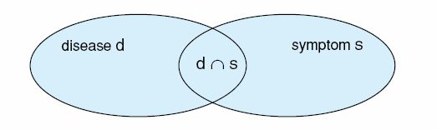



Fig 5.2 A Venn diagram illustrating the calculations of P(d|s) as a function of p(s|d).
Luger: Artificial Intelligence, 6th edition. © Pearson Education Limited, 2009
15

Slide 16

The chain rule for two sets:
The generalization of the chain rule to multiple sets
We make an inductive argument to prove the chain rule, consider the n^{th} case:
We apply the intersection of two sets of rules to get:
And then reduce again, considering that:
Until is reached, the base case, which we have already demonstrated.
Luger: Artificial Intelligence, 6th edition. © Pearson Education Limited, 2009
16

Slide 17
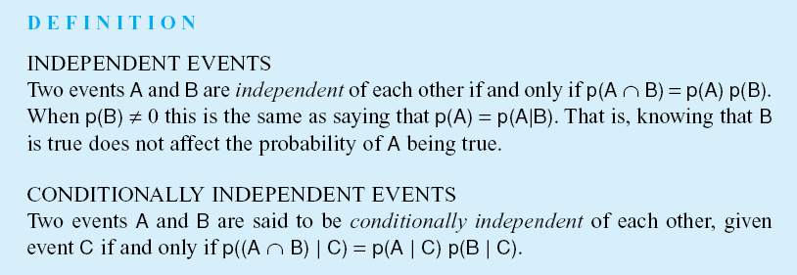
Luger: Artificial Intelligence, 6th edition. © Pearson Education Limited, 2009
17

Slide 18
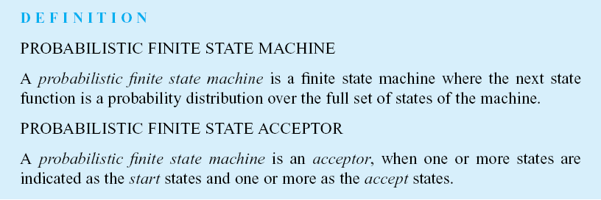
Luger: Artificial Intelligence, 6th edition. © Pearson Education Limited, 2009
18

Slide 19
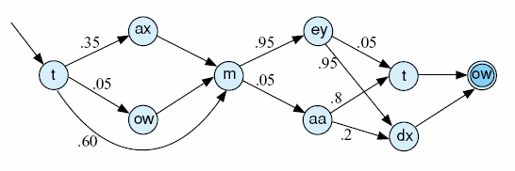
You say [to ow m ey tow] and I say [t ow m aa t ow]…
- Ira Gershwin, Lets Call The Whole Thing Off
Fig 5.3 A probabilistic finite state acceptor for the pronunciation of “tomato”, adapted from Jurafsky and Martin (2000).
Luger: Artificial Intelligence, 6th edition. © Pearson Education Limited, 2009
19

Slide 20
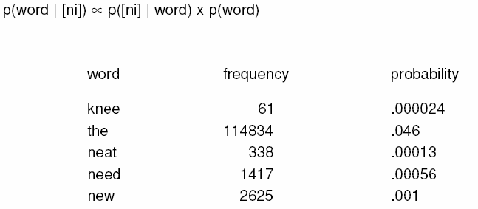
Table 5.2 The ni words with their frequencies and probabilities from the Brown and Switchboard corpora of 2.5M words, adapted from Jurafsky and Martin (2000).
Luger: Artificial Intelligence, 6th edition. © Pearson Education Limited, 2009
20

Slide 21
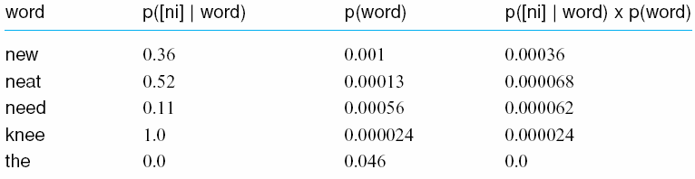
Table 5.3 The ni phone/word probabilities from the Brown and Switchboard corpora (Jurafsky and Martin, 2000).
Luger: Artificial Intelligence, 6th edition. © Pearson Education Limited, 2009
21

Slide 22
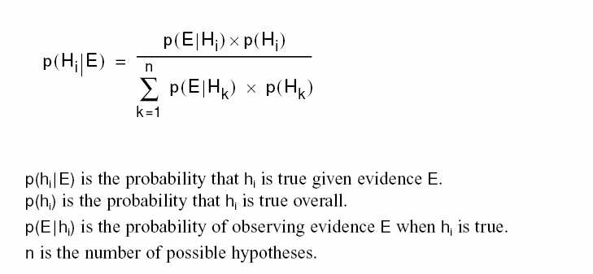
The general form of Bayes’ theorem where we assume the set of hypotheses H partition the evidence set E:
Luger: Artificial Intelligence, 6th edition. © Pearson Education Limited, 2009
22

Slide 23
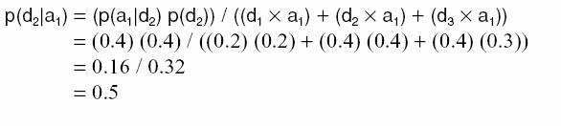
The application of Bayes’ rule to the car purchase problem:
Luger: Artificial Intelligence, 6th edition. © Pearson Education Limited, 2009
23

Slide 24
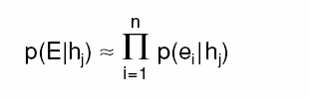
Naïve Bayes, or the Bayes classifier, that uses the partition assumption, even when it is not justified:
Luger: Artificial Intelligence, 6th edition. © Pearson Education Limited, 2009
24

Slide 25
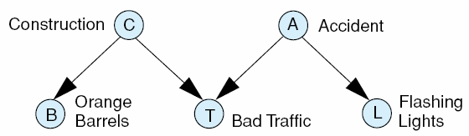
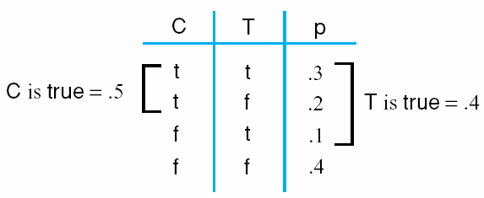
Fig 5.4 The Bayesian representation of the traffic problem with potential explanations.
Table 5.4 The joint probability distribution for the traffic and construction variables of Fig 5.3.
Luger: Artificial Intelligence, 6th edition. © Pearson Education Limited, 2009
25

